Slide 1


Slide 2
Name: K.Prathyusha Reddy
Qualification: B.Tech(ECE)
Title: Analysis on IMDB

Slide 3

WEB SCRAPPING ANALYSIS ON INTERNET MOVIE DATABASE

Slide 4
Introduction of IMDB:
The Internet Movie Database(IMDB) is an online database information related to movies, TV shows, celebrities, genre, reviews etc.
It enables users to rate and search different movies or TV shows of different genres on single platform

Slide 5
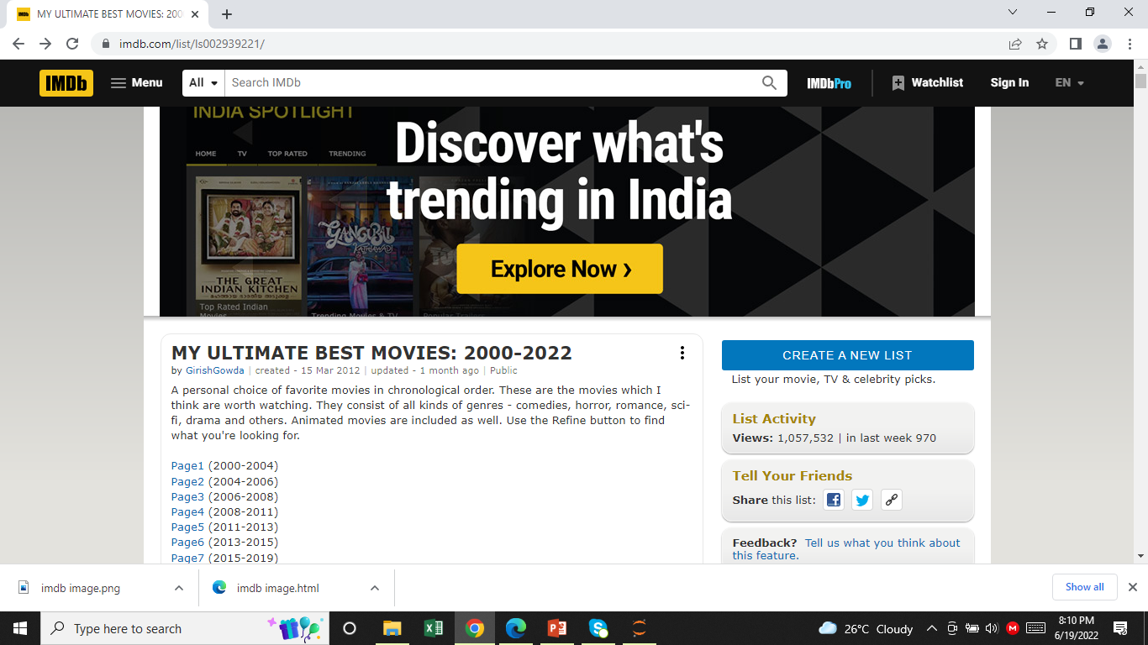
website:

Slide 6
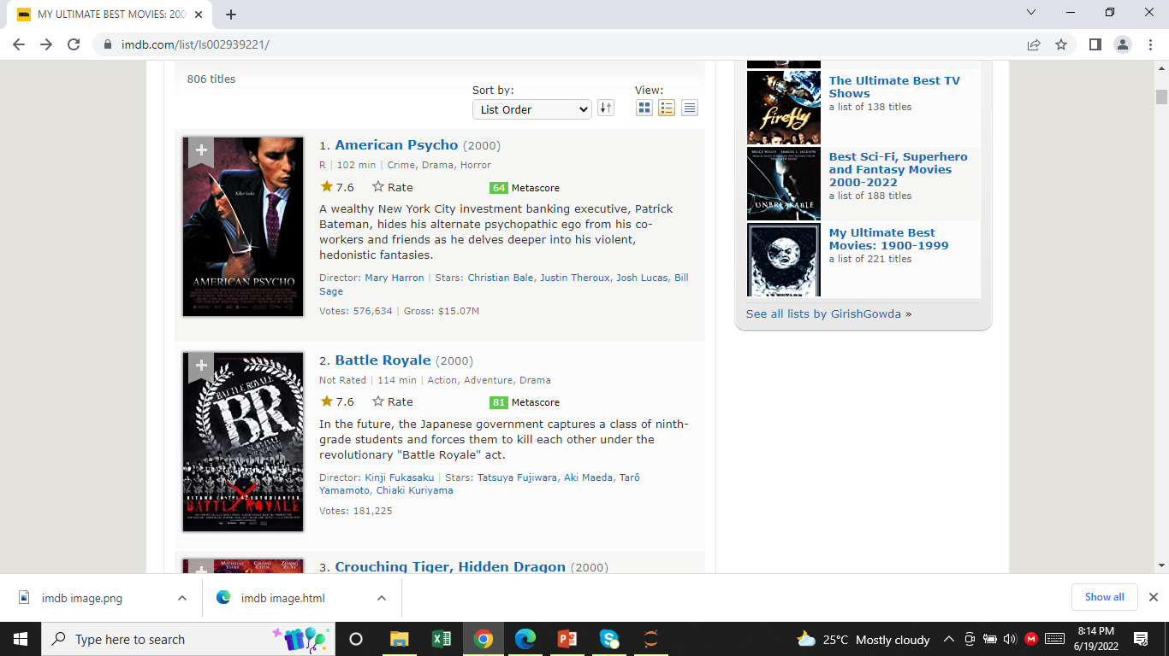
FEATURES: 1.Title 2.Genre 3.Certification 4.Year 5.Time 6.Metascore 7.Rating 8.Voting 9.Gross

Slide 7
IMPORTING THE LIBRARIES
Libraries:
NumPy
Pandas
Matplotlib
Seaborn
Requests
re
Bs 4/ Beautiful Soup
csv

Slide 8
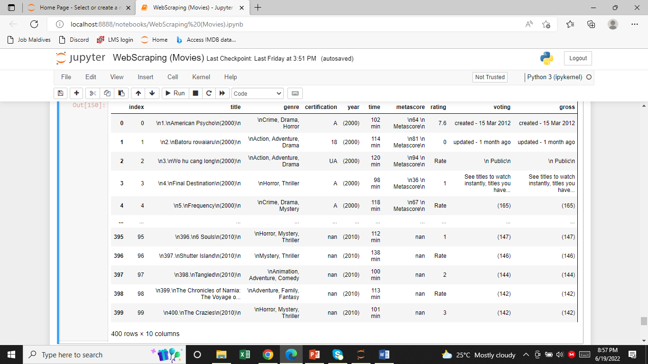
RAW DATA:

Slide 9
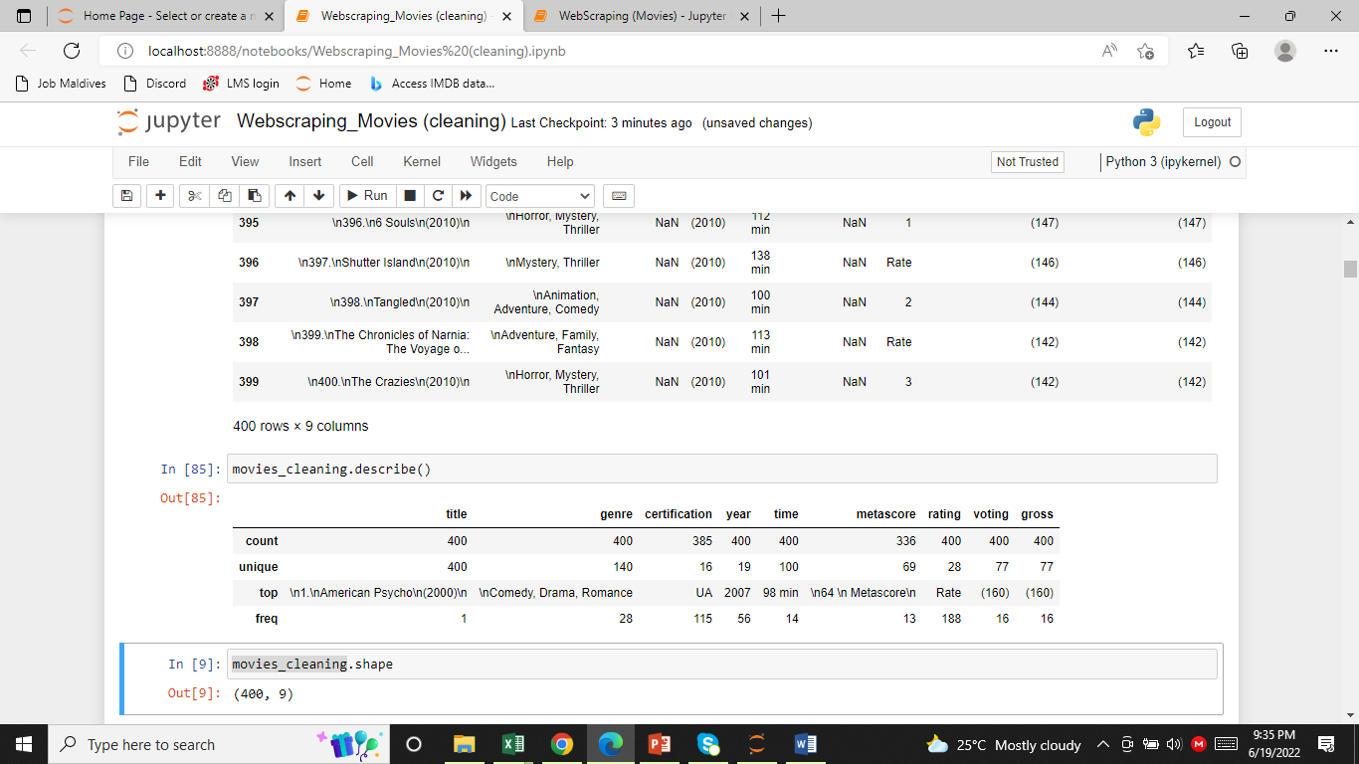
Statistical Values of Data Before Cleaning

Slide 10
DATA CLEANING:
Identifying Null Values.
To fill the Missing Values.
Treating rows and columns with null values and missing values.
Extracting index column from data and create another column using regular expressions.
Treating columns and converting required columns from object to int or float datatype.

Slide 11
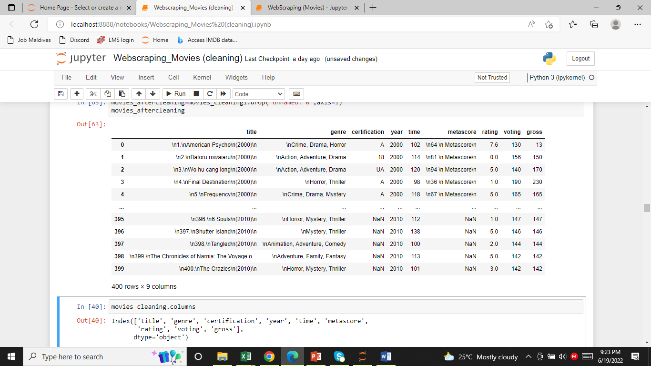
DATAFRAME AFTER CLEANING

Slide 12
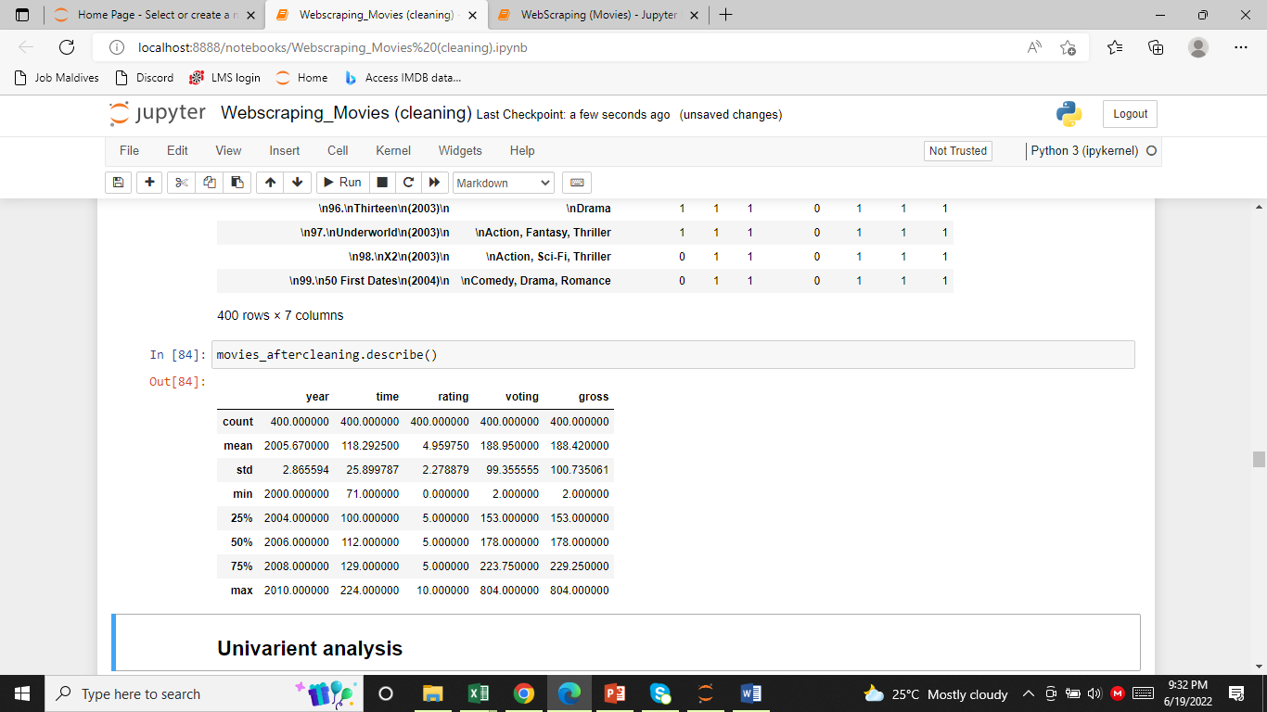
Summary statistics of Data Frame:

Slide 13

VISUALIZATION

Slide 14
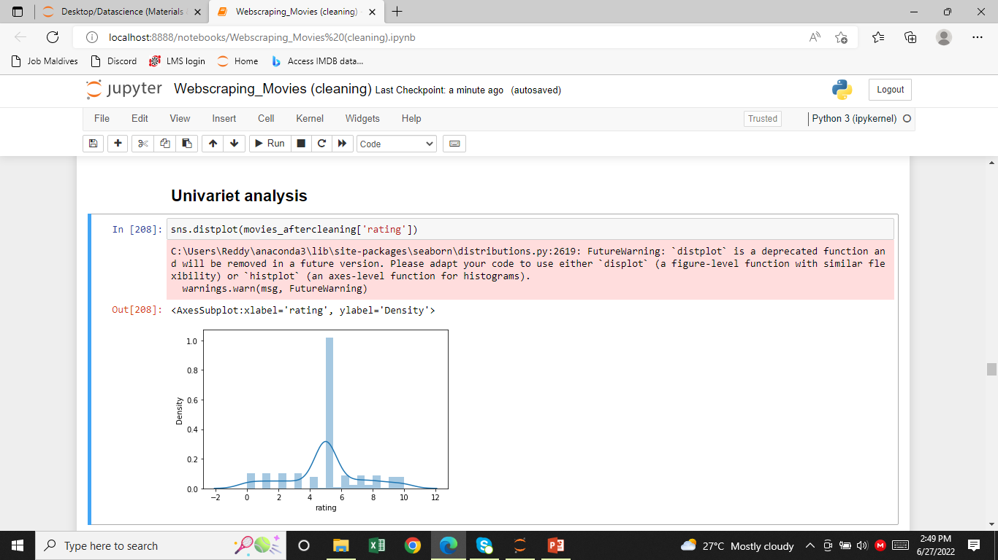
Comparison of ratings with distribution plot:

Slide 15
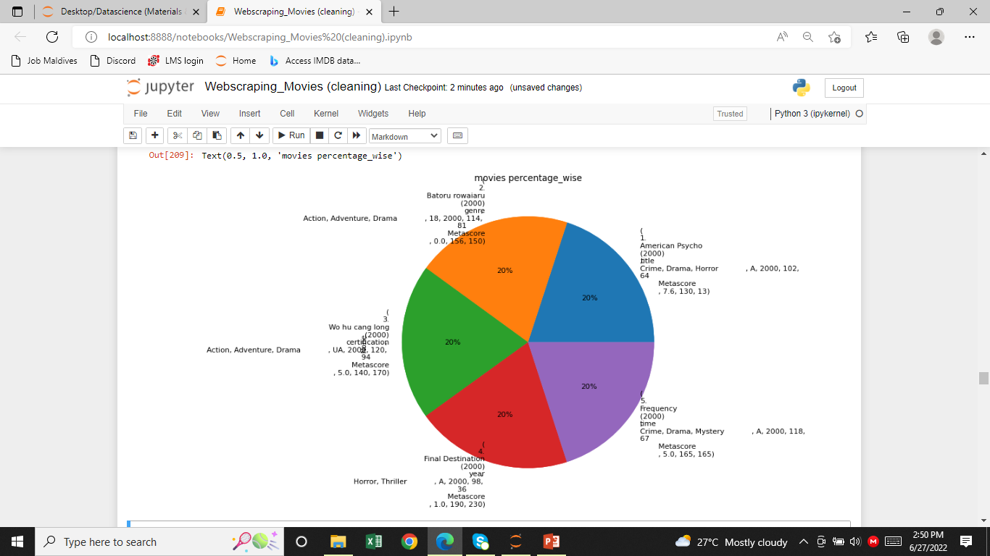
Pie Chart: it is used to find the percentage

Slide 16
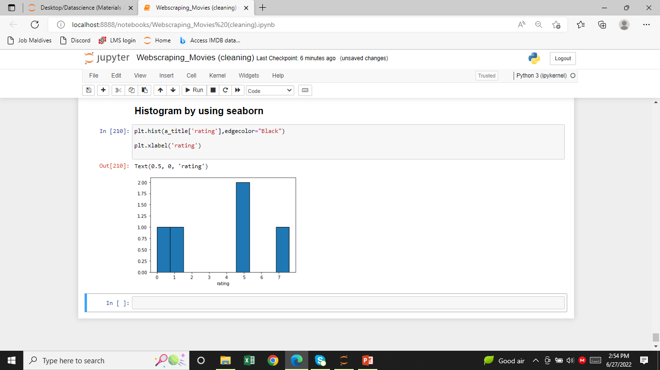
By using Histogram finding the ratings of the movies

Slide 17
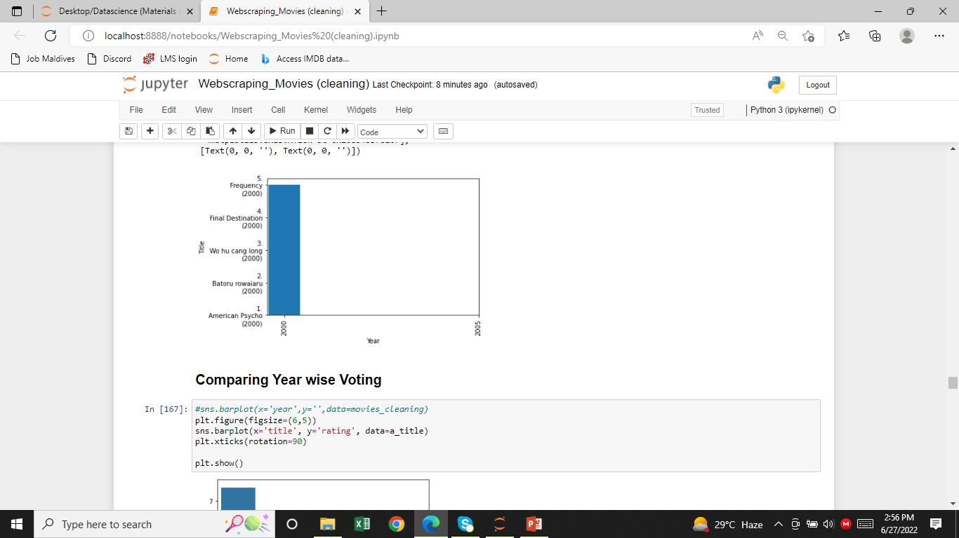
it is used to compare the year and title

Slide 18
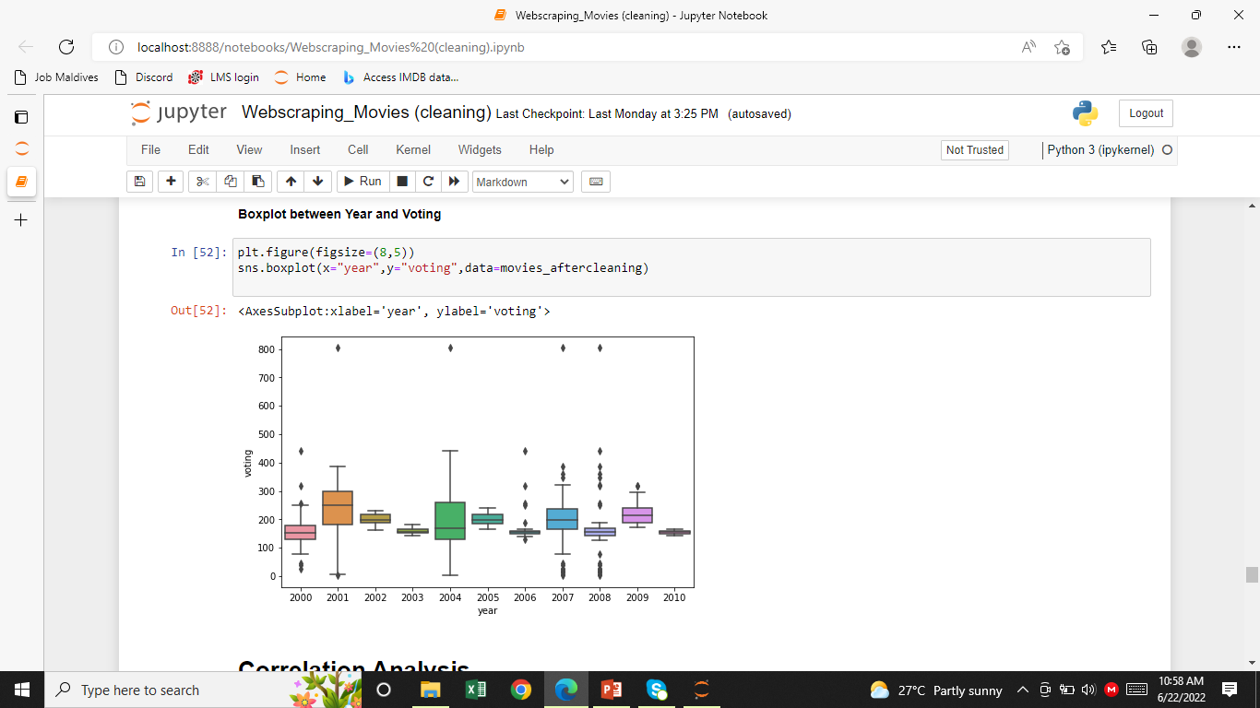
To find the outliers:

Slide 19
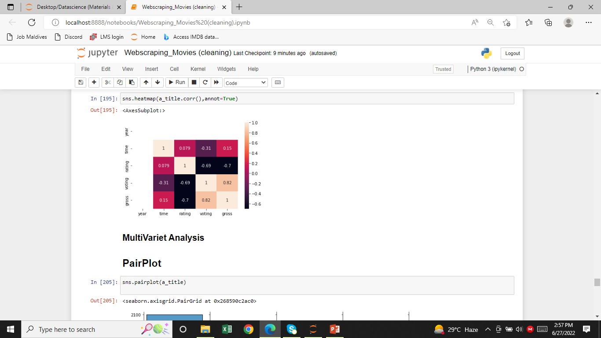
Multivariate Analysis:
Correlation Map:
Time and voting are highly correlated
Year and time are less correlated

Slide 20
CONCLUSION :
• IMDB is a very popular to get information about movies and star cast.
The ratings of movies varies from 1.1 to 10.
There are 3 highest rated movies are in the year 2007 movies.
The average rating of all Indian movies are in 2004 with approximate 5.6 rating.

Slide 21
Keys:
Website used (IMDB)
Features:Title,Genre,Certification,Year,Time,Metascore,Rating,Voting,Gross
Data frame creation
Data cleaning
Data frame after cleaning
Summery statistics
Univariate analysis
Bi variate / multivariate analysis
conclusion

Slide 22

Thank
YOU

